Slide 1
Build Logistic Regression Model on PL_XSELL dataset
Logistic Regression

Slide 2
1. Import Dataset and understand the data.
setwd("C:/Users/Ashish/Desktop/GL/Day3/Homework")
d = read.csv("PL_XSELL_201708.csv")
metadata = read.csv("PL_XSELL_METADATA.csv")
str(d)

Slide 3
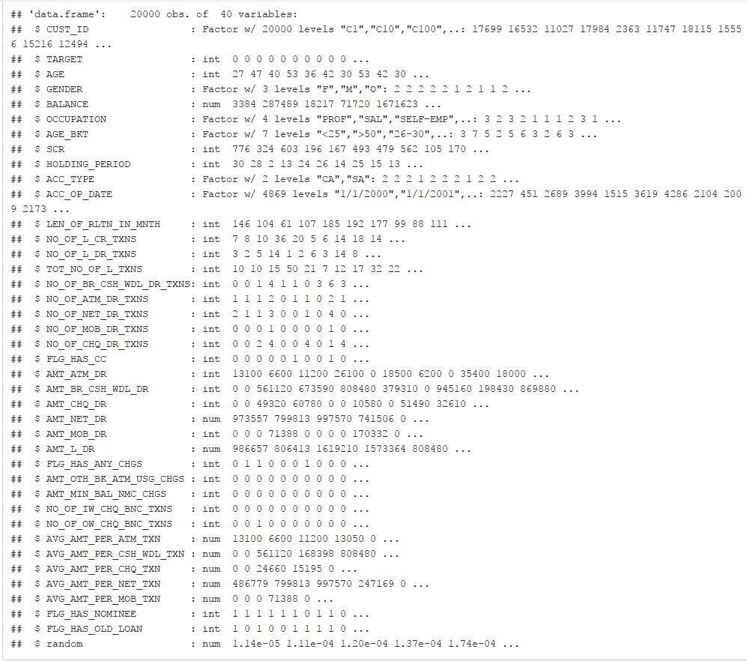

Slide 4
2. Perform Exploratory Data Analysis.
apply(d[,sapply(d, is.numeric)],
2, quantile,
probs=c(0.01, 0.05, 0.1, 0.25, 0.50, 0.75, 0.90, 0.95, 0.99, 1),
na.rm=T)
boxplot(d$BALANCE ,
main= "Balance Box Plot" ,
xlab = "Overall Base")

Slide 5
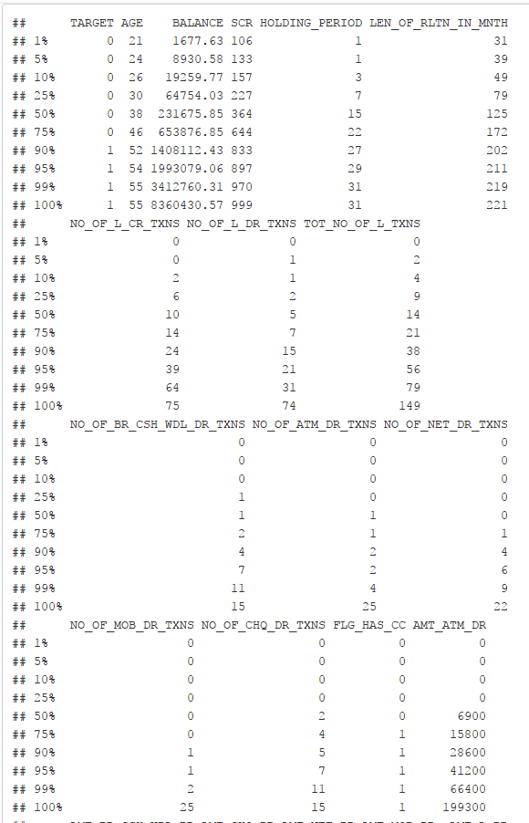
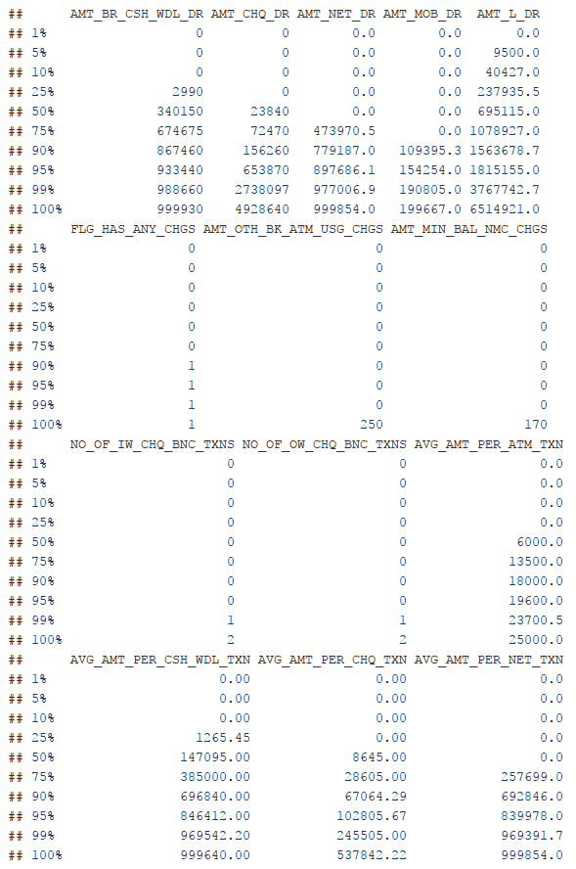

Slide 6
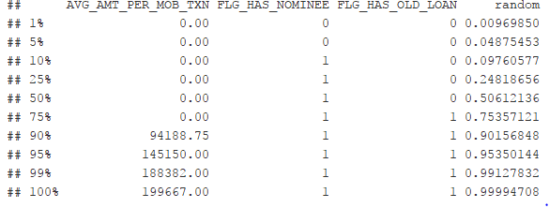
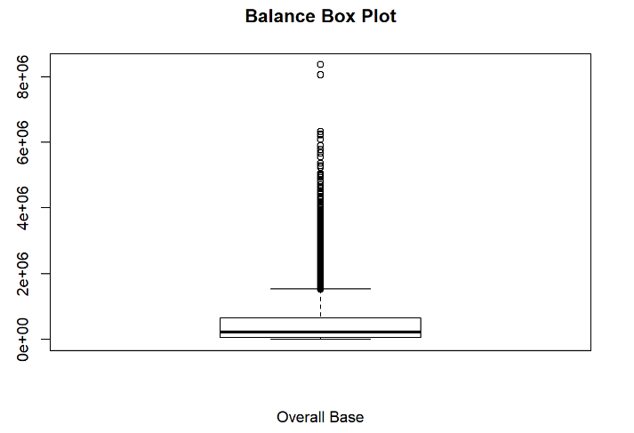

Slide 7
2. Perform Exploratory Data Analysis.
d1$BALANCE = ifelse(d1$BALANCE > 3412762 ,3412762, d1$BALANCE)
d1$TOT_NO_OF_L_TXNS = ifelse(d1$TOT_NO_OF_L_TXNS > 80, 80,d1$TOT_NO_OF_L_TXNS)
d1$NO_OF_ATM_DR_TXNS = ifelse(d1$NO_OF_ATM_DR_TXNS > 5, 5 ,d1$NO_OF_ATM_DR_TXNS)
d1$NO_OF_NET_DR_TXNS = ifelse(d1$NO_OF_NET_DR_TXNS > 10 , 10 , d1$NO_OF_NET_DR_TXNS)
d1$NO_OF_MOB_DR_TXNS = ifelse(d1$NO_OF_MOB_DR_TXNS > 5 ,5 ,d1$NO_OF_MOB_DR_TXNS)
d1$AMT_ATM_DR = ifelse(d1$AMT_ATM_DR > 70000 , 70000 , d1$AMT_ATM_DR)
summary(d1)
str(d1)
d1$ACC_OP_DATE = as.Date(d1$ACC_OP_DATE , "%m/%d/%Y")
d1$NO_OF_DAYS = as.numeric(Sys.Date()-d1$ACC_OP_DATE)
d2 = d1[, !names(d1)%in% "ACC_OP_DATE"]

Slide 8
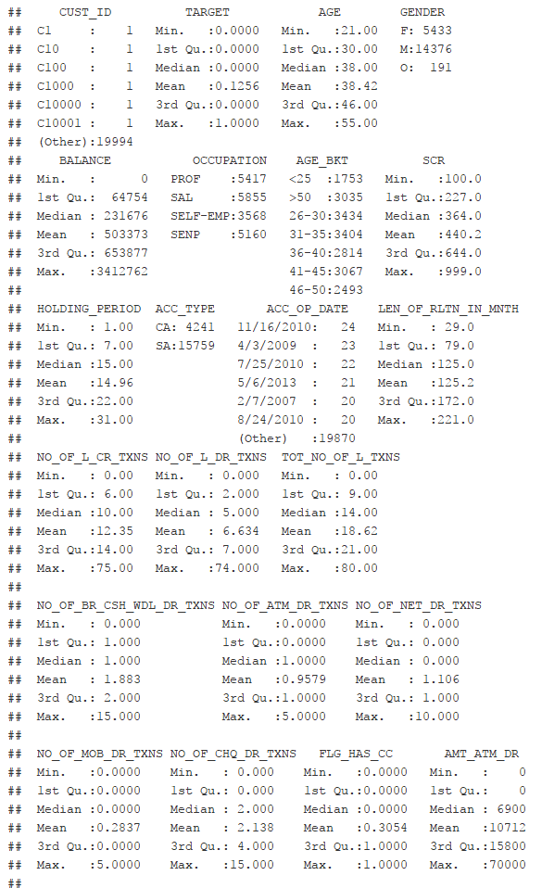
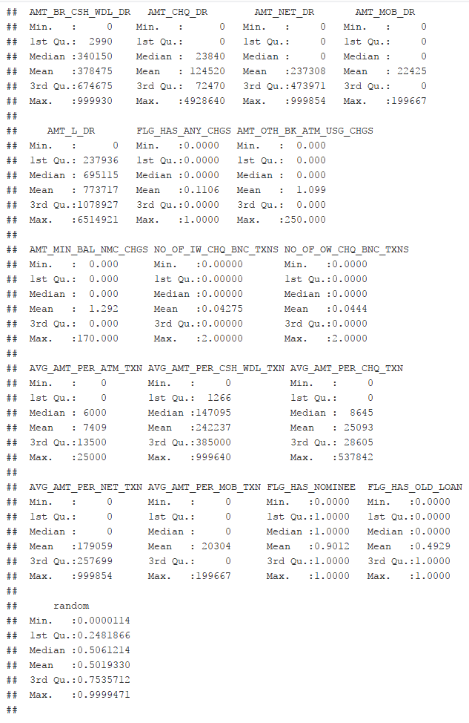

Slide 9
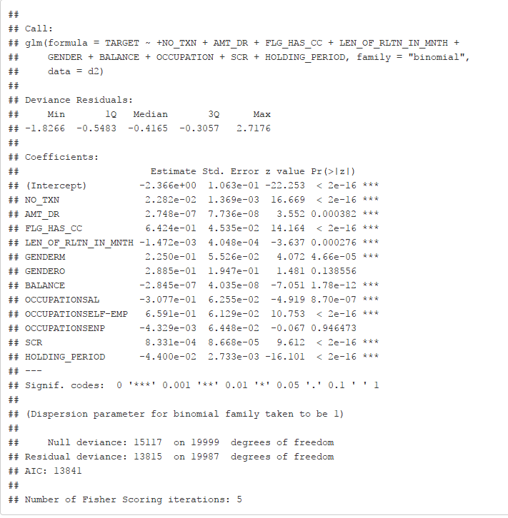
3 . Build Hypothesis
Probability of a TARGET is as a function of the predictor variable(s)

Slide 10
4 . Check Hypothesis using Information Value.
library(devtools)
library(woe)
iv.plot.summary(iv.mult(d2[,!names(d2) %in% c("CUST_ID")],
"TARGET",TRUE, verbose = TRUE))
iv <- iv.mult(d2[,!names(d2) %in% c("CUST_ID")],
"TARGET",FALSE)
iv

Slide 11
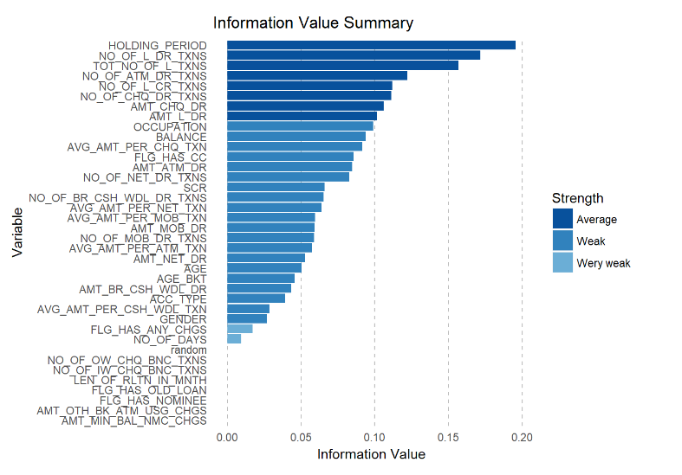

Slide 12
5. Check Hypothesis using Visualization
#install_github("K2Analytics/BinaryTargetViz")
library(BinaryTargetViz)
x <- sapply(sapply(ls(), get), is.data.frame)
m <- data.frame(names(x)[(x == TRUE)])
BinaryTargetViz(m)

Slide 13
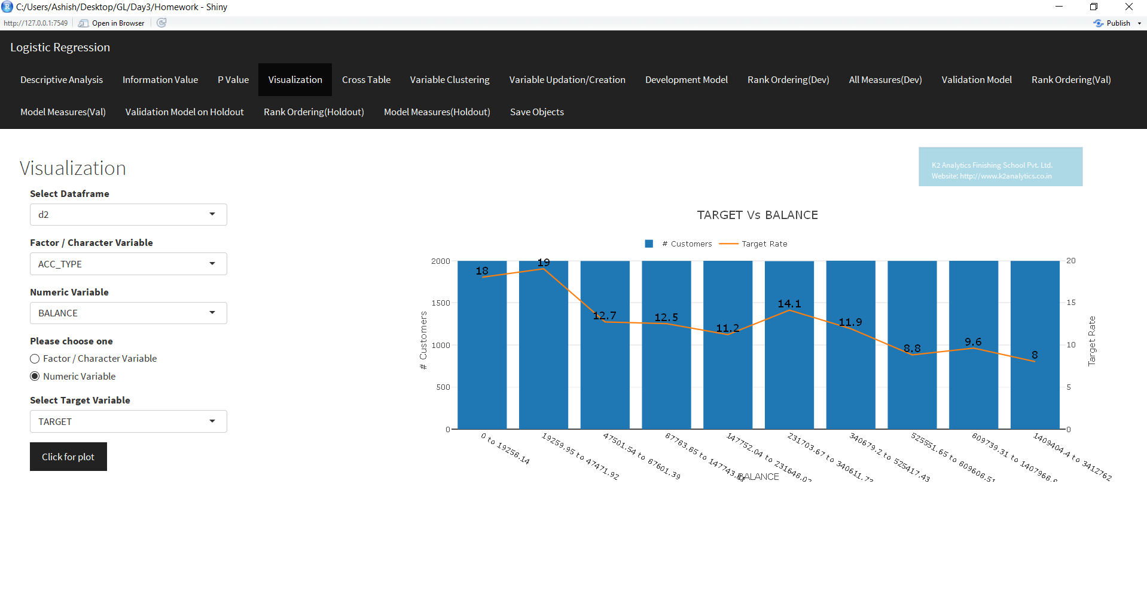

Slide 14
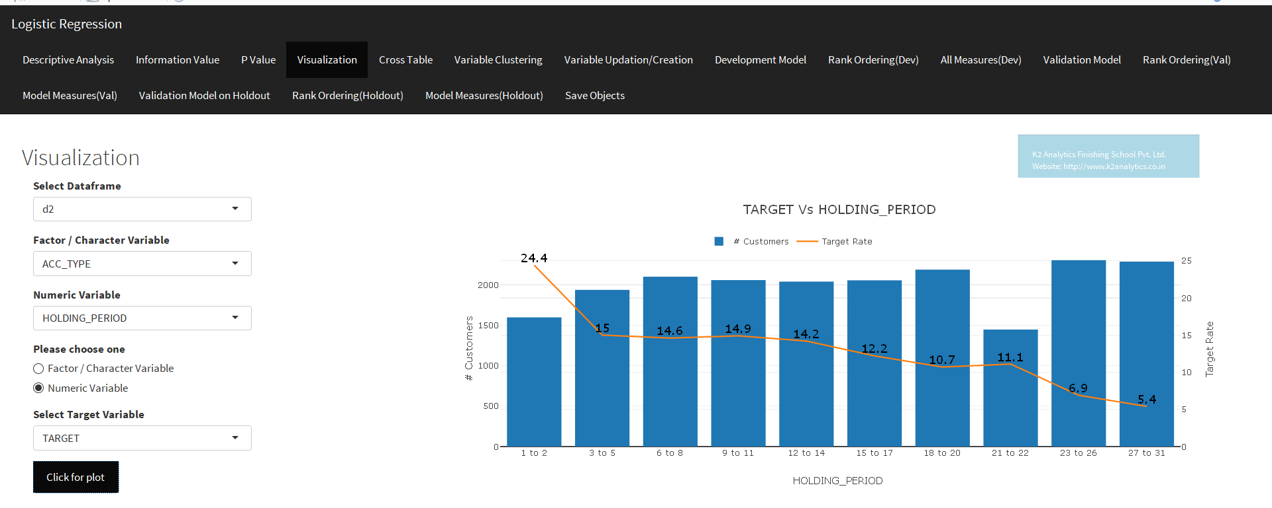

Slide 15
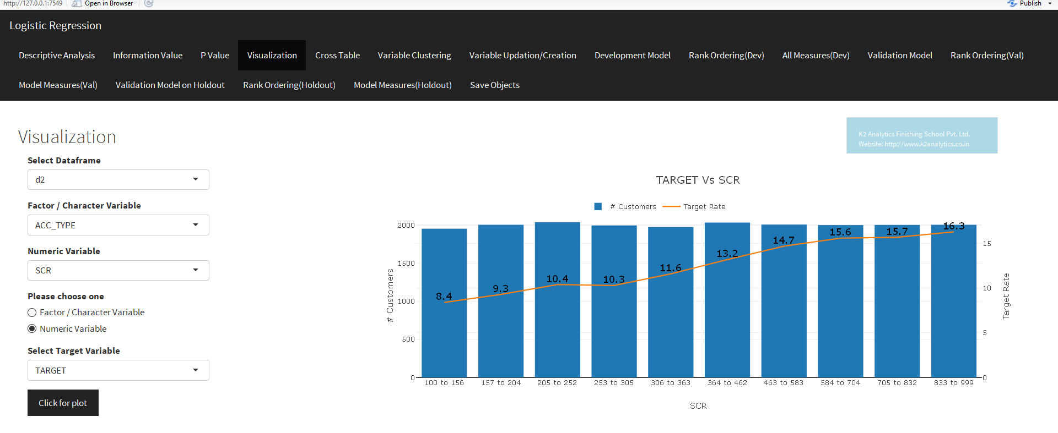

Slide 16
6. Do necessary Variable Transformation.
View(metadata)
# Let's check multicolinearity between variables related to No of transactions
cor(d2[,12:19])
# Let's check multicolinearity between variables related to Amount of transactions
cor(d2[,21:27])
# Let's check multicolinearity between variables related to Avg Amount of transactions
cor(d2[,28:36])
# Let's check multicolinearity between variables related to Avg Amount and Amount of transactions
cor(d2[,c(21,22,23,24,25,26,32,33,34,35,36)])

Slide 17
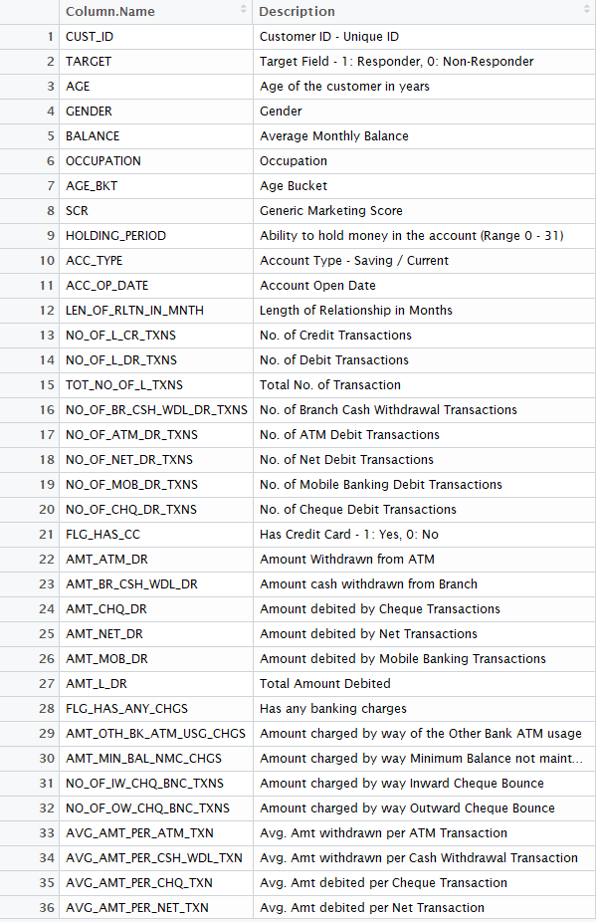
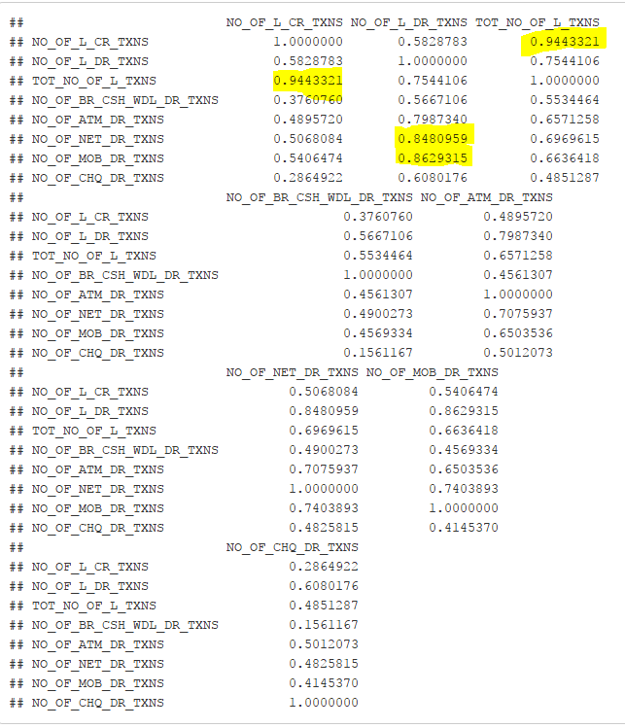

Slide 18
## Running Regression Process to check which variable is useful
d2$NO_TXN = d2$NO_OF_BR_CSH_WDL_DR_TXNS+d2$NO_OF_L_CR_TXNS+d2$NO_OF_CHQ_DR_TXNS
d2$AMT_DR = d2$AVG_AMT_PER_CHQ_TXN+d2$AVG_AMT_PER_NET_TXN+d2$AVG_AMT_PER_ATM_TXN+d2$AVG_AMT_PER_MOB_TXN
mylog = glm(TARGET ~+NO_TXN+AMT_DR+FLG_HAS_CC+LEN_OF_RLTN_IN_MNTH+
GENDER+BALANCE+OCCUPATION+SCR+HOLDING_PERIOD
,data = d2, family = "binomial")
summary(mylog)
library(car)
vif(mylog)

Slide 19
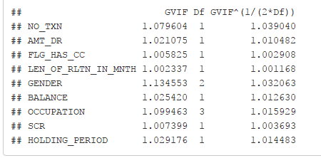

Slide 20
## We need to treat Occupation & Gender Variable
pp <- as.data.frame.matrix(table(d2$OCCUPATION, d2$TARGET))
pp$total <- (pp$`0` + pp$`1`)
pp$rrate <- round(pp$`1` * 100 / (pp$`0` + pp$`1`), 3)
pp
d2$DV_OCC = ifelse ( d2$OCCUPATION %in% c("SAL", "PROF"), "SAL-PROF",
ifelse (
d2$OCCUPATION %in% c("SELF-EMP", "SENP"), "SELF_EMP-SENP",
d2$OCCUPATION ))
table(d2$DV_OCC)
pp2 <- as.data.frame.matrix(table(d2$GENDER ,d2$TARGET))
pp2$total <- (pp2$`0` + pp2$`1`)
pp2$rrate <- round(pp2$`1` * 100 / (pp2$`0` + pp2$`1`), 3)
pp2
d2$DV_G = ifelse ( d2$GENDER %in% c("F","O"), "F-O",
ifelse (
d2$GENDER %in% c("M"), "M",
d2$GENDER))
table(d2$DV_G)

Slide 21
7. Split dataset in Dev-Val-Hold Out samples.
mydata = d2[, names(d2)%in% c("CUST_ID", "NO_TXN","AMT_DR","FLG_HAS_CC","LEN_OF_RLTN_IN_MNTH",
"DV_G","BALANCE","DV_OCC","SCR","HOLDING_PERIOD","random","TARGET")]
View(mydata)
mydata$random <- runif(nrow(mydata), 0, 1)
mydata.dev <- mydata[which(mydata$random <= 0.6),]
mydata.val <- mydata[which(mydata$random > 0.6
& mydata$random <= 0.8 ),]
mydata.hold <- mydata[which(mydata$random > 0.8),]

Slide 22
8. Build Logistics Regression Model on Dev
mylog1 = glm(TARGET ~+NO_TXN+AMT_DR+FLG_HAS_CC+
DV_G+BALANCE+DV_OCC+SCR+HOLDING_PERIOD
,data = mydata.dev, family = "binomial")
summary(mylog1)

Slide 23
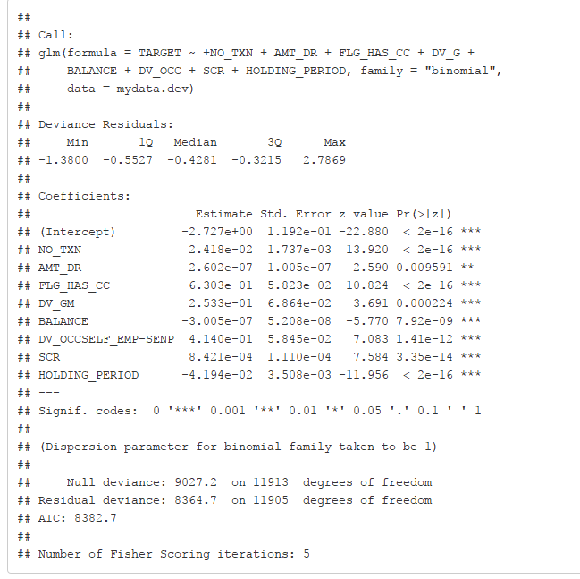

Slide 24
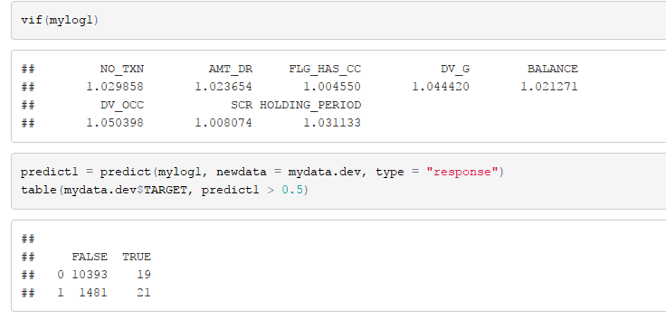
9. Ensure No Multi Collinearity between variables.
vif(mylog1)
predict1 = predict(mylog1, newdata = mydata.dev, type = "response")
table(mydata.dev$TARGET, predict1 > 0.5)

Slide 25
10. Check Model Performance Measures. ## Rank Ordering Test##
mydata.dev$prob <- predict(mylog1, mydata.dev, type="response")
mydata.dev$deciles <- decile(mydata.dev$prob)
library(data.table)
library(scales)
tmp_DT = data.table(mydata.dev)
rank <- tmp_DT[, list(
cnt = length(TARGET),
cnt_resp = sum(TARGET),
cnt_non_resp = sum(TARGET == 0)) ,
by=deciles][order(-deciles)]
rank$rrate <- round (rank$cnt_resp / rank$cnt,3);
rank$cum_resp <- cumsum(rank$cnt_resp)
rank$cum_non_resp <- cumsum(rank$cnt_non_resp)
rank$cum_rel_resp <- round(rank$cum_resp / sum(rank$cnt_resp),3);
rank$cum_rel_non_resp <- round(rank$cum_non_resp / sum(rank$cnt_non_resp),3);
rank$ks <- percent(abs(rank$cum_rel_resp - rank$cum_rel_non_resp));
rank$rrate <- percent(rank$rrate)
rank$cum_rel_resp <- percent(rank$cum_rel_resp)
rank$cum_rel_non_resp <- percent(rank$cum_rel_non_resp)
View(rank)

Slide 26
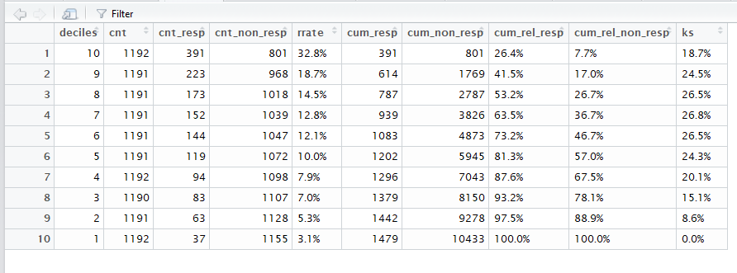

Slide 27

####### Goodness of Fit: ######
ttt <- data.table(mydata.dev)
library(sqldf)
sqldf('select deciles, count(1) as cnt_cust,
sum(TARGET) as cnt_resp,
sum(prob) as est_rep
from ttt
group by deciles')
hosmerlem <- function (y, yhat, g = 10) {
cutyhat <- cut(yhat, breaks = quantile(yhat, probs = seq(0,
1, 1/g)), include.lowest = T)
obs <- xtabs(cbind(1 - y, y) ~ cutyhat)
expect <- xtabs(cbind(1 - yhat, yhat) ~ cutyhat)
chisq <- sum((obs - expect)^2/expect)
P <- 1 - pchisq(chisq, g - 2)
c("X^2" = chisq, Df = g - 2, "P(>Chi)" = P)}
hl_gof = hosmerlem(mydata.dev$TARGET, mydata.dev$prob )
hl_gof

Slide 28
#***FUNCTION TO CALCULATE CONCORDANCE AND DISCORDANCE***#
concordance=function(y, yhat)
{
Con_Dis_Data = cbind(y, yhat)
ones = Con_Dis_Data[Con_Dis_Data[,1] == 1,]
zeros = Con_Dis_Data[Con_Dis_Data[,1] == 0,]
conc=matrix(0, dim(zeros)[1], dim(ones)[1])
disc=matrix(0, dim(zeros)[1], dim(ones)[1])
ties=matrix(0, dim(zeros)[1], dim(ones)[1])
for (j in 1:dim(zeros)[1])
{
for (i in 1:dim(ones)[1])
{
if (ones[i,2]>zeros[j,2])
{conc[j,i]=1}
else if (ones[i,2]<zeros[j,2])
{disc[j,i]=1}
else if (ones[i,2]==zeros[j,2])
{ties[j,i]=1}
}
}
Pairs=dim(zeros)[1]*dim(ones)[1]
PercentConcordance=(sum(conc)/Pairs)*100
PercentDiscordance=(sum(disc)/Pairs)*100
PercentTied=(sum(ties)/Pairs)*100
return(list("Percent Concordance"=PercentConcordance,"Percent Discordance"=PercentDiscordance,"Percent Tied"=PercentTied,"Pairs"=Pairs))
}

Slide 29
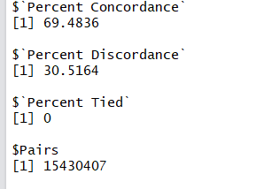

#***FUNCTION TO CALCULATE CONCORDANCE AND DISCORDANCE ENDS***#
concordance_output = concordance(mydata.dev$TARGET, mydata.dev$prob)
concordance_output
mydata.dev$Class = ifelse (mydata.dev$prob>0.2, 1, 0)
table(mydata.dev$TARGET, mydata.dev$Class)

Slide 30
######## GINI Index ########
#install.packages("ineq")
library(ineq)
gini = ineq(mydata.dev$prob, type="Gini")
gini

Slide 31

## Calculating AUC using ROC Curve and KS for the model
#install.packages("ROCR")
library(ROCR)
pred <- prediction(mydata.dev$prob, mydata.dev$TARGET)
perf <- performance(pred, "tpr", "fpr")
plot(perf, col="green", lwd=2, main="ROC Curve")
abline(a=0,b=1,lwd=2,lty=2,col="gray")
KS <- max(attr(perf, 'y.values')[[1]]-attr(perf, 'x.values')[[1]])
auc <- performance(pred,"auc");
auc <- as.numeric(auc@y.values)
KS
auc

Slide 32
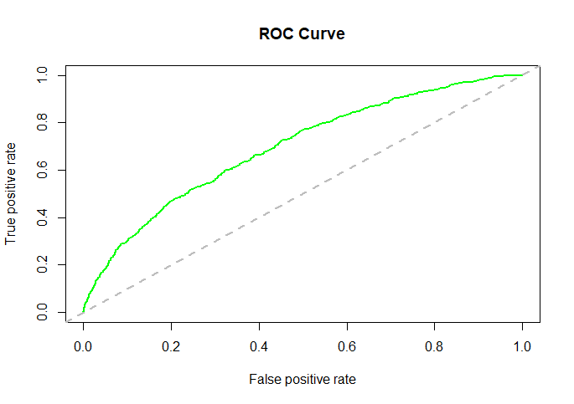
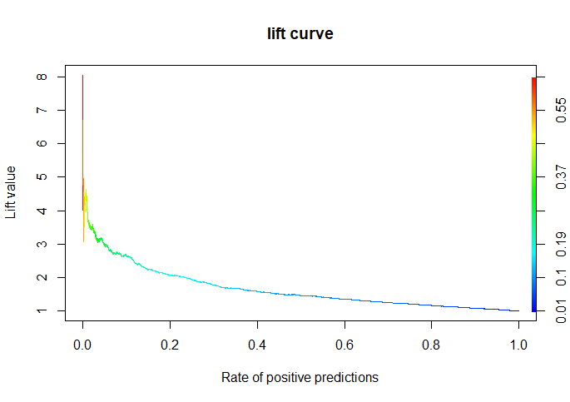

Slide 33
11.Validate the Model
predict1 = predict(mylog1, newdata = mydata.dev, type = "response")
table(mydata.dev$TARGET, predict1 > 0.5)
Confident % = 87.4 %
#library(devtools)
#install_github("K2Analytics/logisticmodelcreation")
library(plotly)
library(logisticmodelcreation)
x <- sapply(sapply(ls(), get), is.data.frame)
m <- data.frame(names(x)[(x == TRUE)])
logisticmodelcreation(m)

Slide 34
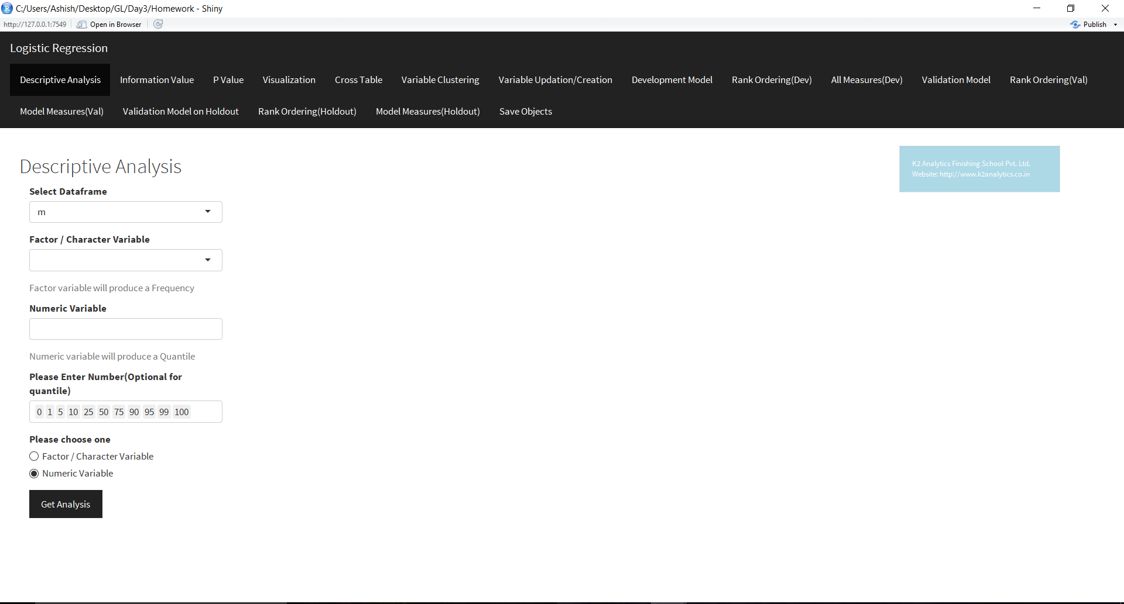

Slide 35
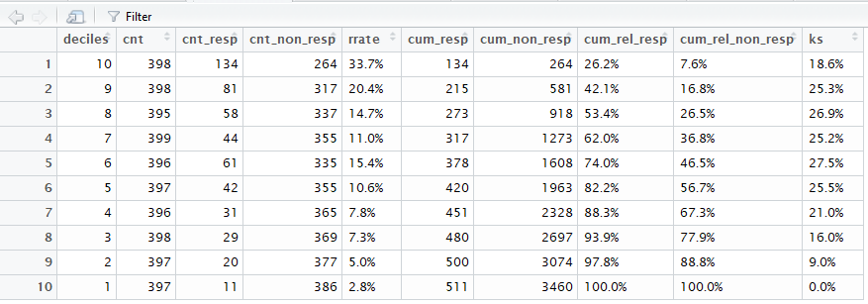
12.Finally check model performance on Hold Out. # Rank Hold

Slide 36

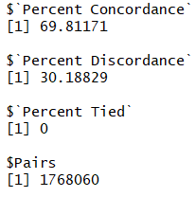



# Goodness of FIT
#CALCULATE CONCORDANCE AND DISCORDANCE
#GINI INDEX

